Slide 1
TODAY YOU WILL:
ORDER THIS PLEASE!
Practice creating different parts of the essay
Check each other’s essays
Get no homework
Play a game
Write an essay
Play another game
Notes:
This material is intended for students in the 2nd grade of Grammar school and above, after they have already learnt the basics about writing an argumentative/ for and against essay. It can be used a s a supplement to the textbook or individually, in parts or as a whole.
Use this slide as a warmer activity – asl students to predict the order in which they wil ldo the activities

Slide 2
FOR AND AGAINST/ ARGUMENTATIVE ESSAY
TODAY YOU WILL
Play a game
Practice creating different parts of the essay
Write an essay
Check each other’s essays
Play another game
Get no homework

Slide 3
WHAT DO YOU KNOW ABOUT YOUR ESSAY TASK?
What do you have to do?
How many parts should your essay have?
Word count? Word limit?
How much time have you got for your essay?
Notes:
Talk to the students about the mature exam writing task. Check how much they know, clear any misunderstandings or confusions (especially false comparisons with the Croatian essay)

Slide 4
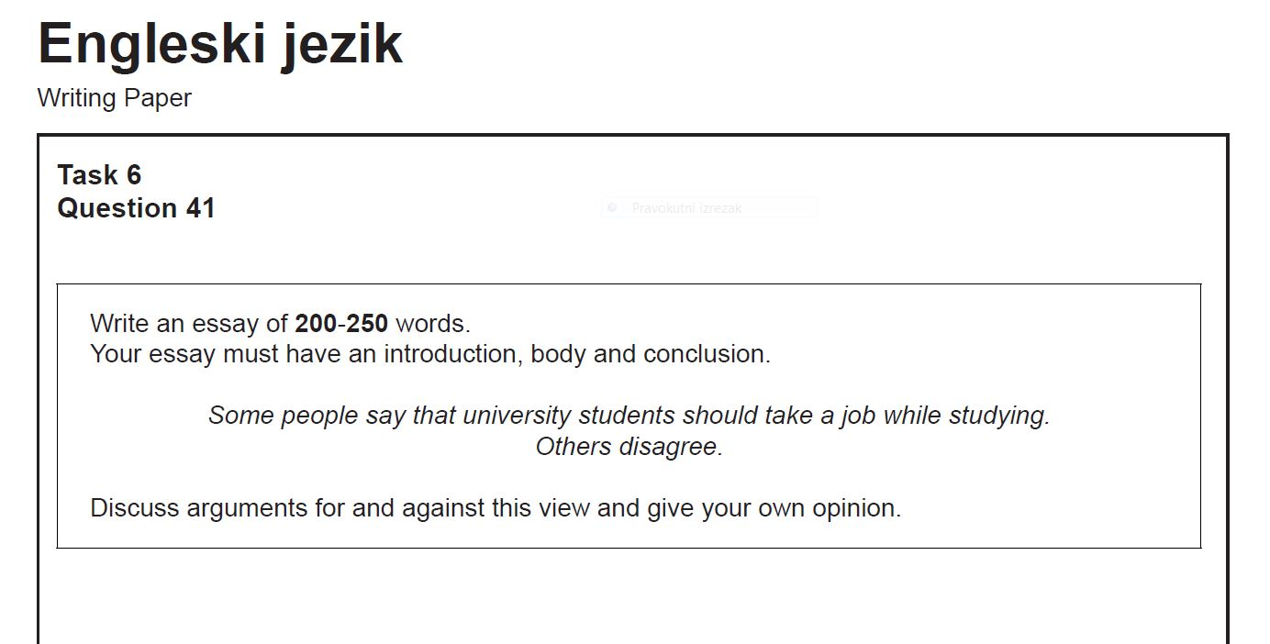
ESSAY TASK – 75’
Notes:
Present the task format to the students

Slide 5
STEPS IN THE WRITING PROCESS
(DON’T) PANIC!!!
Brainstorm ideas and vocabulary
Organize your ideas
Plan paragraphs
Write first draft
Check language
Write final draft
Which step is the easiest? Why?
Which step is the most difficult? Why? How do you make it less difficult?
Which step is the shortest? Why?
Which step is the longest? Why?
Notes:
Raise awarenes about the writing process, discuss the questions with the students

Slide 6
Put the sentences into the correct order – Worksheet B
INTRO – X, X
BODY 1 – X,X,X,X,X,X,X
BODY 2- X, X, X, X, X, X
CONCLUSION - X, X
Notes:
At this stage of the preparation for the essay, distribute the example essay to the students (WORKSHEET B of the document in the same folder as this presentation) cut it in sentence slips marked with the letters A-R). Students have to order the sentences. Assist them as they do the task since they have never seen the text before. Start with identifying the title (printed in italics) and then ask them to distribute the sentences according to the paragraphs they belong, check and proceed to putting them in the exact order they appear in the example essay. Use the next slide to check.
This is a pairwork or a group work activity.

Slide 7
Put the sentences into the correct order – Worksheet B
INTRO - D, A
BODY 1 - C, B, F, E, H, L, R
BODY 2- G, K, J, N, I, O,
CONCLUSION - M, P
Notes:
At this stage of the preparation for the essay, distribute the example essay to the studnets (WORKSHEET B of the document in the same folder as this presentation) cut it in sentence slips marked with the letters A-R). Students have to order the sentences. Assist them as they do the task since they have never seen the text before. Start with identifying the title (printed in italics) and then ask them to distribute the sentences according to the paragraphs they belong to U ovom dijelu pripreme podijelite učenicima (rad u paru ili grupi) izrezane rečenice eseja (Worksheet B u dokumentu u istoj mapi u kojoj je ova prezentacija). Učenici trebaju posložiti rečenice u 4 odlomka, po mogućnosti pravim redoslijedom. Kao lakšu verziju možete im dati zadatak da rasporede rečenic eprema odlomcima

Slide 8
STRUCTURE OF A FOR AND AGAINST ESSAY
INTRODUCTION - general statements about the topic
- thesis statement (praphrased topic OF THE WHOLE ESSAY)
BODY PARAGRAPH 1 -topic sentence (FOR) ili drugi dio teze
- argument 1 + support and examples
- argument 2 + support and examples
- argument 3 + support and examples
- concluding sentence (preferably)
BODY PARAGRAPH 2 - topic sentence (AGAINST) ili drugi dio teze
- argument 1 + support and examples
- argument 2 + support and examples
- argument 3 + support and examples
- concluding sentence (preferably)
CONCLUSION - summary of the main arguments from both body paragraphs
- your opinion
Notes:
Study the essay structure with the students, identify which the sentences in the essay belong to which part of the structure and how they contribute to the overal structure. Make clear that 2 arguments per paragraph are obligatory and the third is optional, warn them that writing too much may lead to loss of coherence if not done properly, but that there is no penalty for exceeding the number of words. 250 words is the word limit that should not be exceeded by too many words (I usually tell my students that 400 words is ok and will not be penalised but 1500 is definitely too much to stay coherent.

Slide 9
Some people say that technological advances mean a better and a brighter future. Others disagree.
From inventing the wheel to today's nanotechnology – man has not stopped creating to make progress. Whereas many people believe there is no other way to a better future but through further development of technology, we can hardly be sure that technology doesn't have negative aspects as well.
On the one hand technology enables us to be positive about our future. First of all, technological advances will make our lives more enjoyable. Let's take, for example, robotics. Soon, we will be able to have domestic robots for household chores and we and forget all about vacuuming or taking out the garbage. Secondly, thanks to technology, communication is going to improve. In the future, we will be doing everything over social networks – from everyday shopping, to doctor’s appointments and studying. Surely, we may conclude that technological development does ensure a better future for mankind.
However, there’s room for some pessimism about our future because of technology. Firstly, the development of technology is unpredictable, and we are not aware of the dangers it might bring. To illustrate this, when Nobel invented dynamite, he didn’t know people would use it for destruction. Moreover, many people might lose their jobs because new technology will replace them. For instance, robots can work 24/7 without having to eat or rest, so people will become unnecessary. Indeed, due to technological advances, we could expect a worrisome future.
To conclude, while we can be optimistic about our future because technology will improve many aspects of our lives, robot helpers and advanced communication being some of them, it also gives us reasons to be concerned because it brings threats to our security and employability. Personally, I want to believe that technology will only bring us positive changes, but we should be aware that our future with technology is uncertain at best.
Notes:
Use this essay to check the order of the sentences from the previous pair/group work activity or use a printed version from the worksheet accompanying this ppt.

Slide 10
Some people say that technological advances mean a better and a brighter future. Others disagree.
From inventing the wheel to today's nanotechnology – man has not stopped creating to make progress. Whereas many people believe there is no other way to a better future but through further development of technology, we can hardly be sure that technology doesn't have negative aspects as well.
On the one hand technology enables us to be positive about our future. First of all, technological advances will make our lives more enjoyable. Let's take, for example, robotics. Soon, we will be able to have domestic robots for household chores and we and forget all about vacuuming or taking out the garbage. Secondly, thanks to technology, communication is going to improve. In the future, we will be doing everything over social networks – from everyday shopping, to doctor’s appointments and studying. Surely we may conclude that technological development does ensure a better future for mankind.
However, there’s room for some pessimism about our future because of technology. Firstly, the development of technology is unpredictable and we are not aware of the dangers it might bring. To illustrate this, when Nobel invented dynamite, he didn’t know people would use it for destruction. Moreover, many people might lose their jobs because new technology will replace them. For instance, robots can work 24/7 without having to eat or rest, so people will become unnecessary. Indeed, due to technological advances, we could expect a worrisome future.
To conclude, while we can be optimistic about our future because technology will improve many aspects of our lives, robot helpers and advanced communication being some of them, it also gives us reasons to be concerned because it brings threats to our security and employability. Personally, I want to believe that technology will only bring us positive changes, but we should be aware that our future with technology is uncertain at best.
Notes:
Highlight the function of linking words and phrases, talk about their contribution to the coherence and the cohesion of the essay.

Slide 11
LET’S STUDY THE PARTS OF THE ESSAY TOGETHER

Slide 12
Some topics from past examination papers
Some people say that watching a movie based on a book is far more exciting than reading the book. Others disagree.
Some people think that university students should take a job while studying. Others disagree.
Some people say that 18-year-olds are too young to vote. Others disagree.
Some people say that surveillance cameras in schools will improve discipline. Others think they endanger the privacy of students.
Some people prefer continuous testing during the whole school year. Others prefer final exams at the end of the year.
Many people believe that school trips should be educational. Others believe they should be a relaxing experience after hard work during the school year.
Notes:
Point out there are two different topic formats (bullets 1-3 AND 4-6). Make clear how the students should appropach them (discuss BOTH VIEWS (bulets 4-6), not necessarily only write arguments for and against.
Suggestions/ideas for pair work activities:
Ask students to write a thesis statment for each of the topics and follow up by writing the whole introduction. Practice paraphrasing.
Ask students to write topic sentences for body paragraphs for each topic. Practice parapohrasing.
Ask students to do a brainstorm for each of the topics. Afterwards, make pairs exchange their brainstorm ideas with other pairs and check each other’s work, add more ideas, discuss the quality of arguments, vocabulary…

Slide 13
INTRODUCTION
- something general about the topic
Question, quotation, statistics, general statements
- thesis statement (praphrased topic) – mention both sides of the topic, avoid repeating the exact words
Notes:
At this point you can switch to another worksheet to study the structure of each paragraph – use WORKSHEEZ-essay practice, Worksheet A in the document.

Slide 14
BODY PARAGRAPH 1
- topic sentence (FOR / one of the views)
- argument 1 + support and examples
- argument 2 + support and examples
- argument 3 + support and examples
- concluding sentence (preferably)
Notes:
Demonstrate each part of the paragraph in the example essay

Slide 15
BODY PARAGRAPH 2
- topic sentence (AGAINST / the other view)
- argument 1 + support and examples
- argument 2 + support and examples
- argument 3 + support and examples
- concluding sentence (preferably)
Notes:
Demonstrate each part of the paragraph in the example essay

Slide 16
CONCLUSION
- summary of the main arguments from both body paragraphs
- your opinion
Notes:
Demonstrate each part of the paragraph in the example essay

Slide 17
Linking devices
Ordering arguments – first of all, second(ly), to begin with, next…
Addition – besides, moreover, furthermore, in addition to this…
Contrast – on the other hand, however, while, whereas, although, in contrast to…
Cause and effect – because, since, due to (the fact that)…
Result – as a result, therefore, so, consequently…
Notes:
Go through the list of linking devices and clarify their meaning and function, use the document named TEXT ORGANIZERS AND GUIDELINES… to complement this slide)

Slide 18
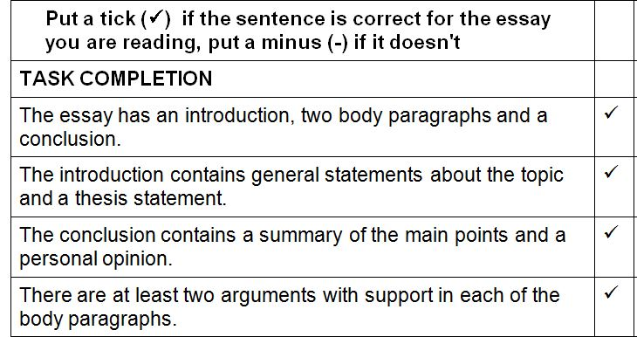
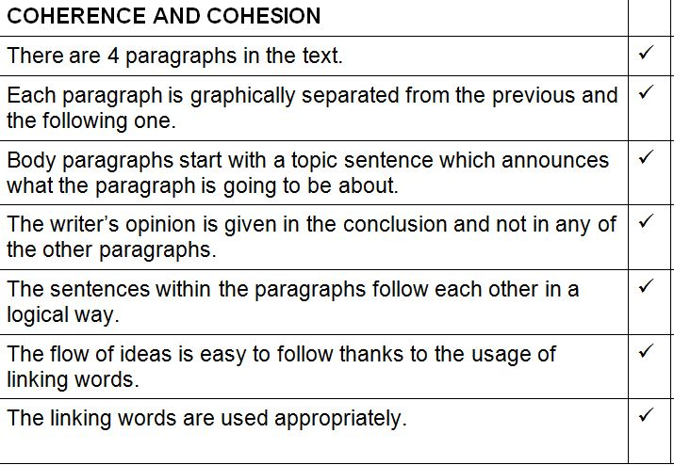
Notes:
Explain how a check list might be useful in the writing process.

Slide 19
The Internet is bad for friendships and relationships. Discuss.
Write an essay of 200-250 words
Your essay should have an introduction, body and conclusion
Discuss arguments for and against theis view and give your own opinion
Notes:
Introduce the topic, use the ideas on the next slide as a guided writing activity for practicing the writing process and the structure of the essay.

Slide 20
IN YOUR GROUP WRITE AN ESSAY ON THE GIVEN TOPIC. YOU CAN DIVIDE THE GROUP INTO SMALLER SUBGROUPS THAT WILL EACH WRITE ONE PART OF THE ESSAY, OR THE WHOLE GROUP CAN WRITE THE ESSAY TOGETHER.
The internet is bad for friendships and relationships. Discuss.
BRAINSTORM: (jumbled arguments)
_____ You can make a lot of friends very easily.
_____ It’s difficult to know if people are being honest.
_____ You make friends with people you wouldn’t usually meet.
_____You can meet people from all over the world.
_____ You need a computer and a good internet connection.
_____You have to wait for a reply when you make a comment.
_____ It is less interesting because you can’t go out to different places together.
_____ It is easier to find people who share the same interests as you.
Write F (for) or A (against) next to each argument.
Plan the second and the third paragraphs for the given essay title – choose two arguments for and two against and think of a supporting statement or an example for each argument.
Plan what to write in which part of the essay with the rest of your group.
Notes:
Use this as a pair work or a group work activity. Do a peer check activity after students write their essays, suggest changes and improvements, highlight great examples of arguments and well written paragraphs)
Alternatively, you can use already written examples of students’ essays to analyse the most common mistakes (documents ANALIZA ESEJA-prazno i ANALIZA ESEJA – puno in the folder)

Slide 21
REMEMBER!!!
WRITING IS A PROCESS!!!
PLANNING AND ORGANIZATION ARE ESSENTIAL!!!

